Slide 1
MassMutual DSDP 2019: Interaction
June 26, 2019
R. Jordan Crouser
Assistant Professor of Computer Science
Smith College

Slide 2
Outline
Mini-lab: #badviz
Interaction and Analysis
Definition
Interaction with data and problem space
Interaction with visual interfaces
BREAK
Introduction to plotly

Slide 3
Mini-lab: #badviz
Break into groups of 2-3 people, and go to:
http://www.science.smith.edu/~jcrouser/design
Goal: critique some professionally-made visualizations
Try to think about the following questions:
What is the first thing you notice about this visualization?
What point is this visualization trying to make?
Who is the intended audience?
What is the visualization doing well?
What problems do you see with the visualization design?
Why do you think the designer made those choices?

Slide 4
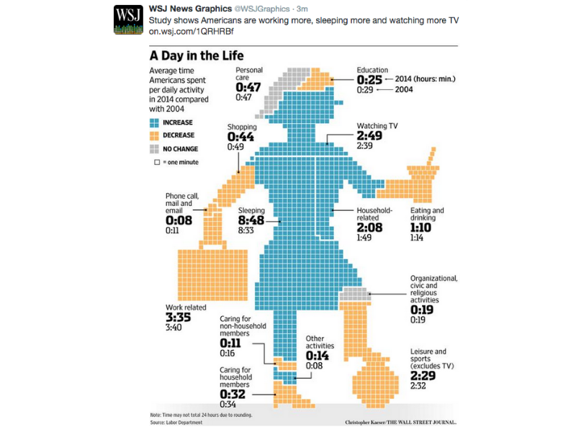

Slide 5


Slide 6
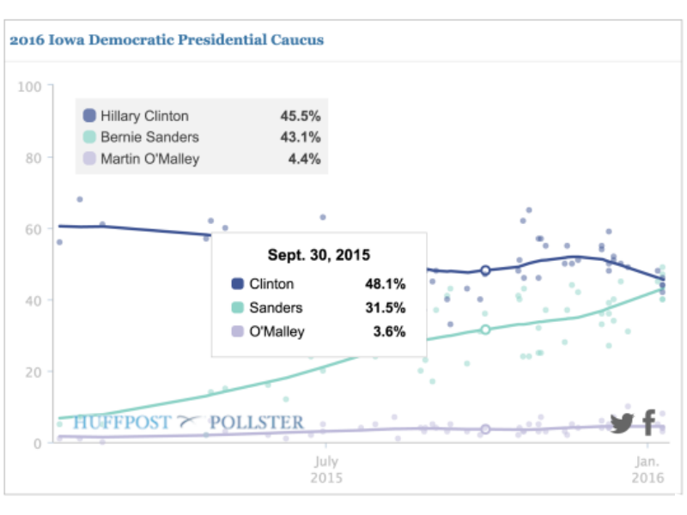

Slide 7
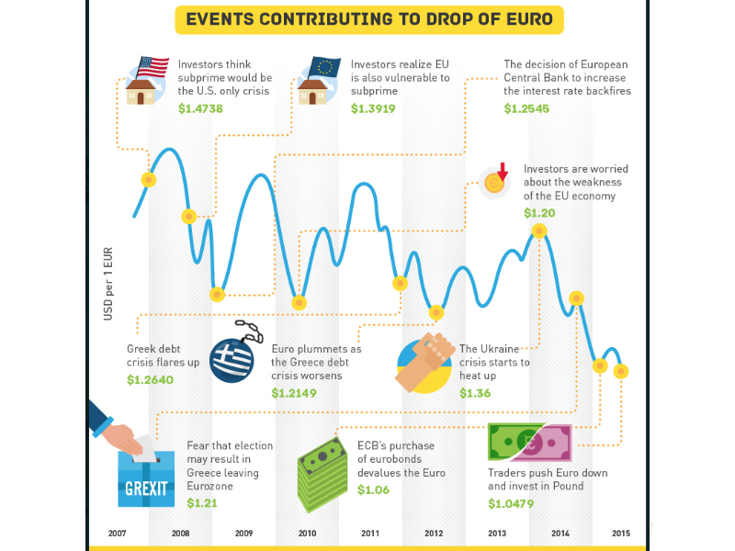

Slide 8


Slide 9
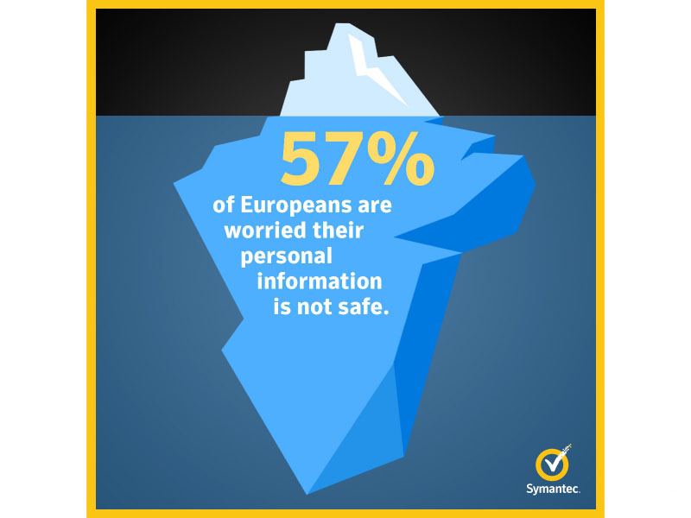

Slide 10
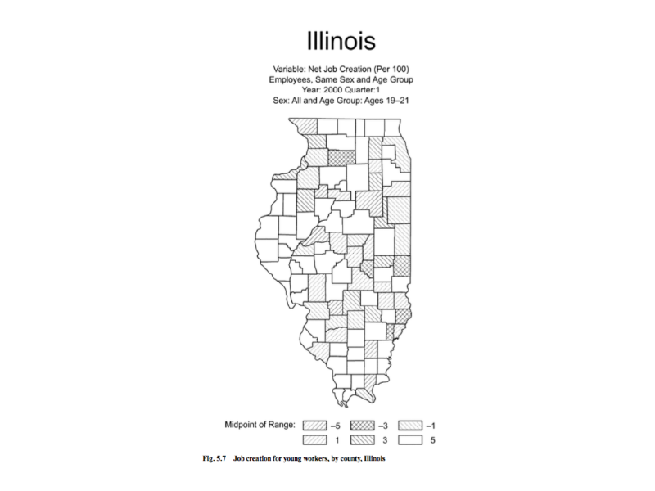

Slide 11
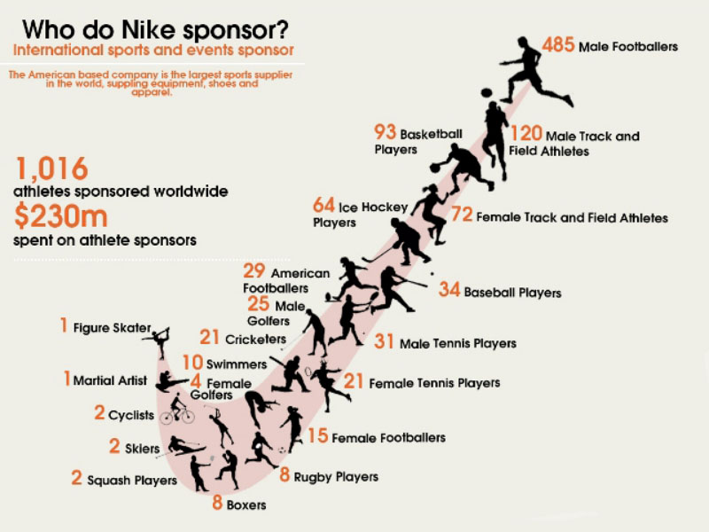

Slide 12
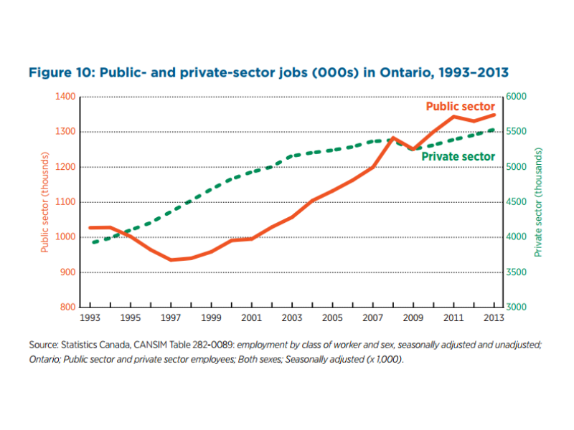

Slide 13
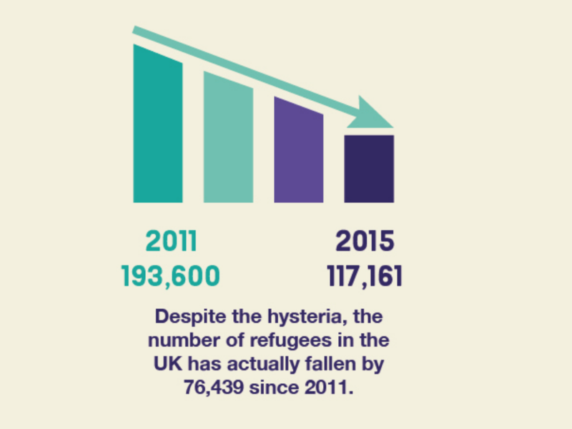

Slide 14
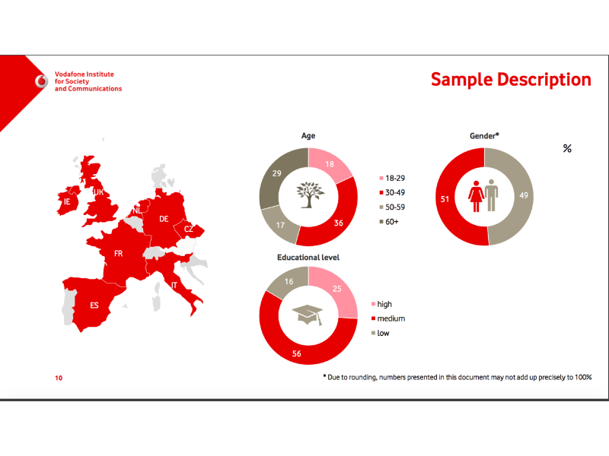

Slide 15
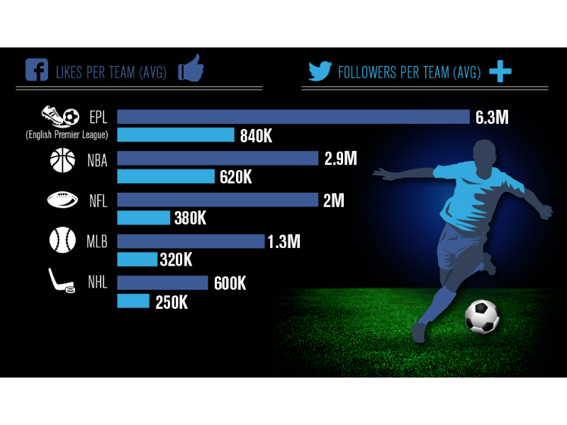

Slide 16
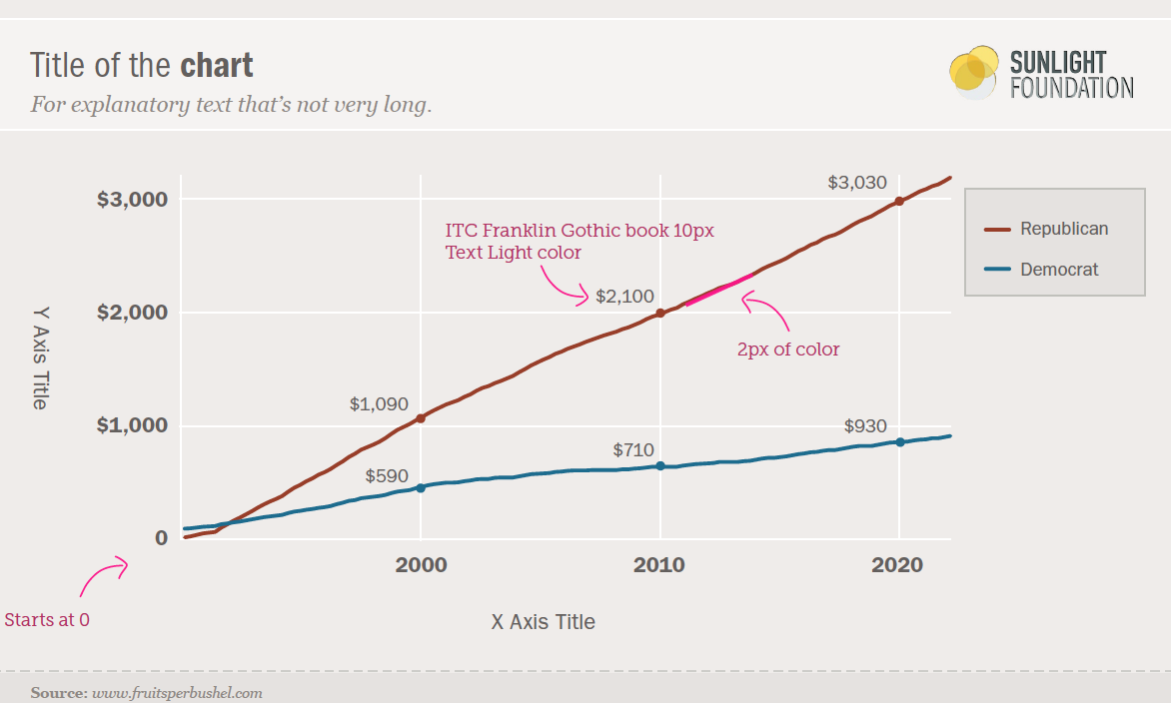
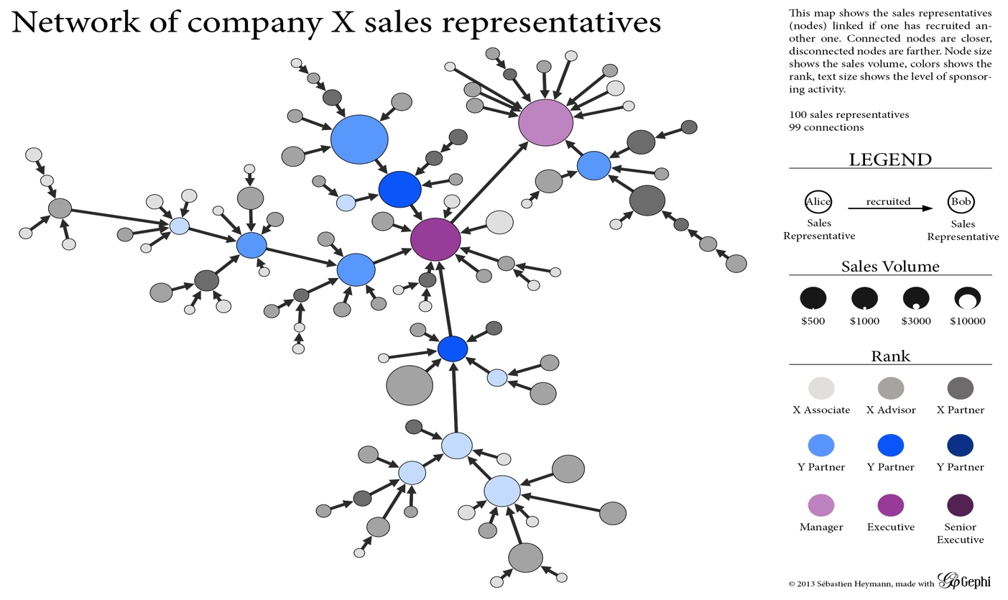
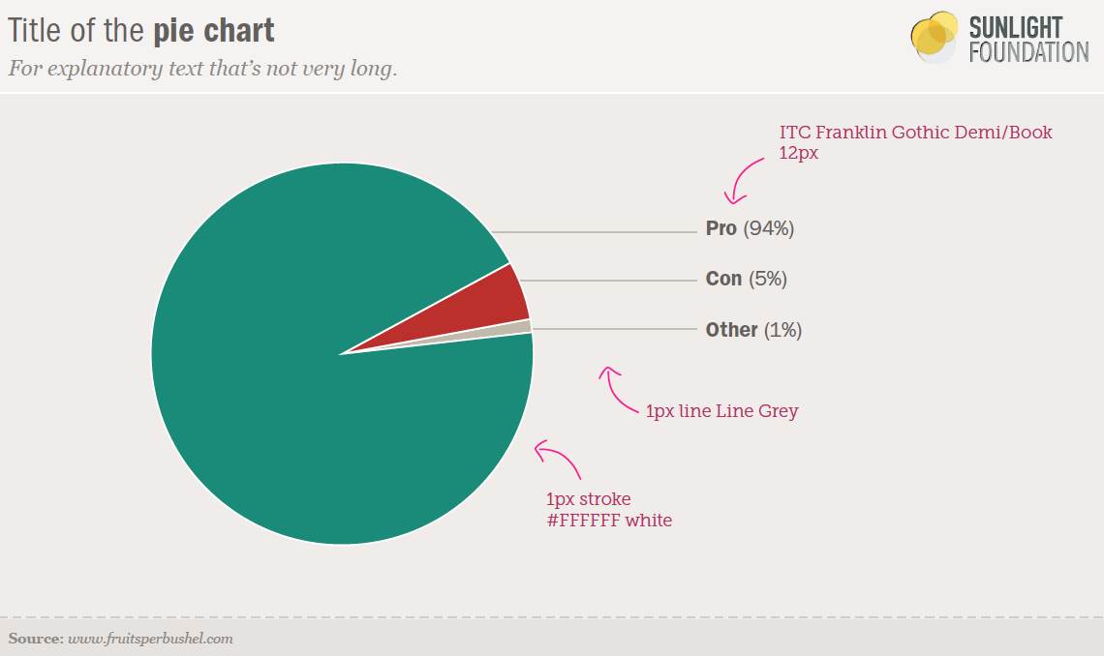
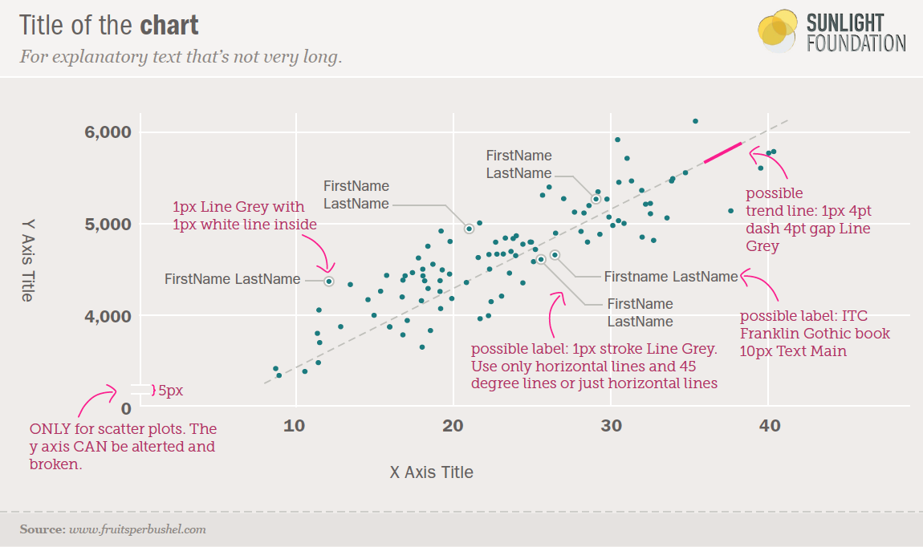
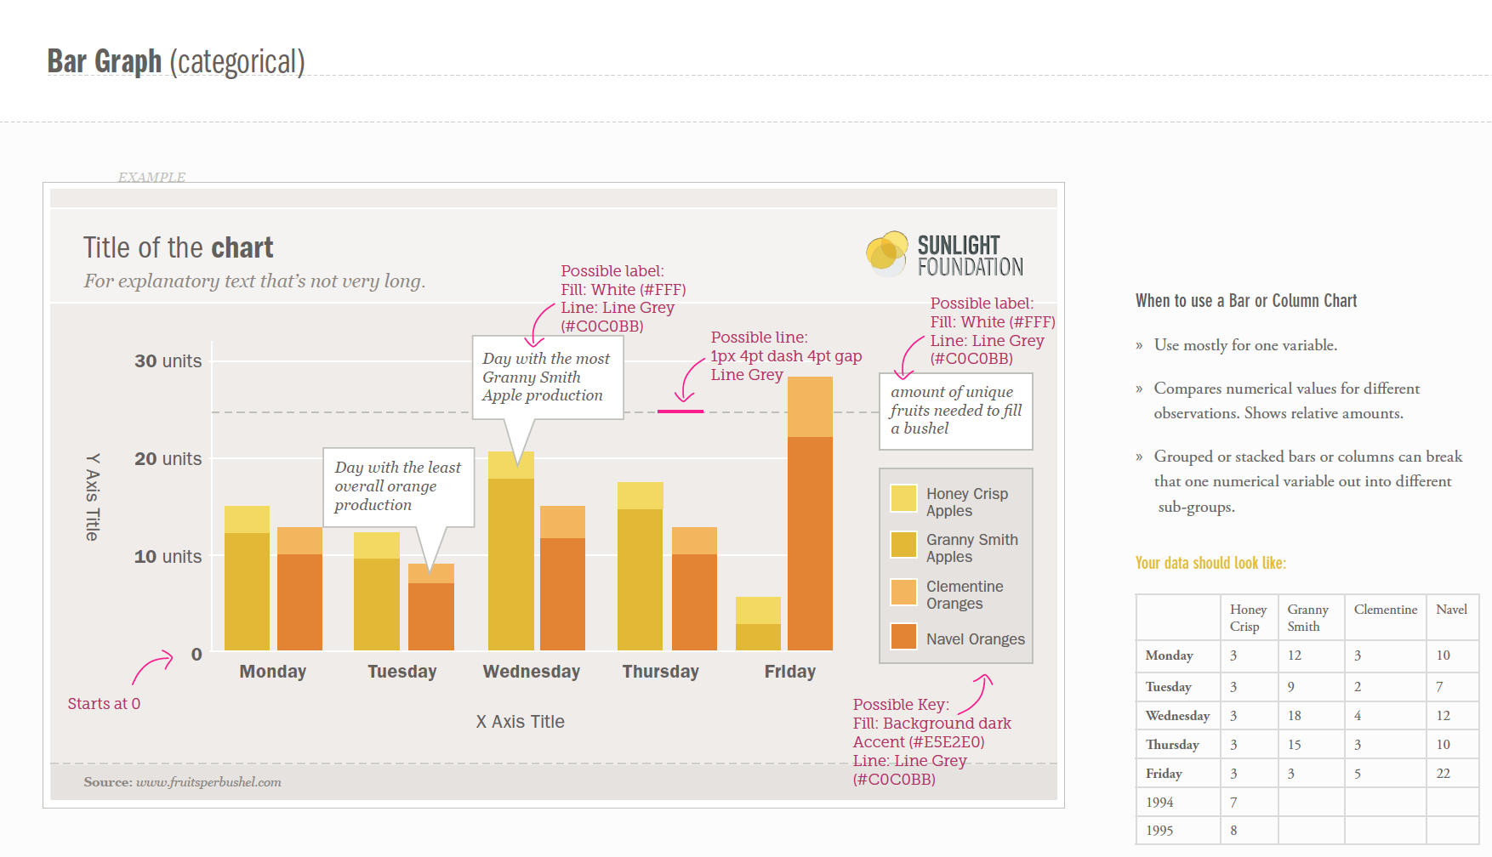
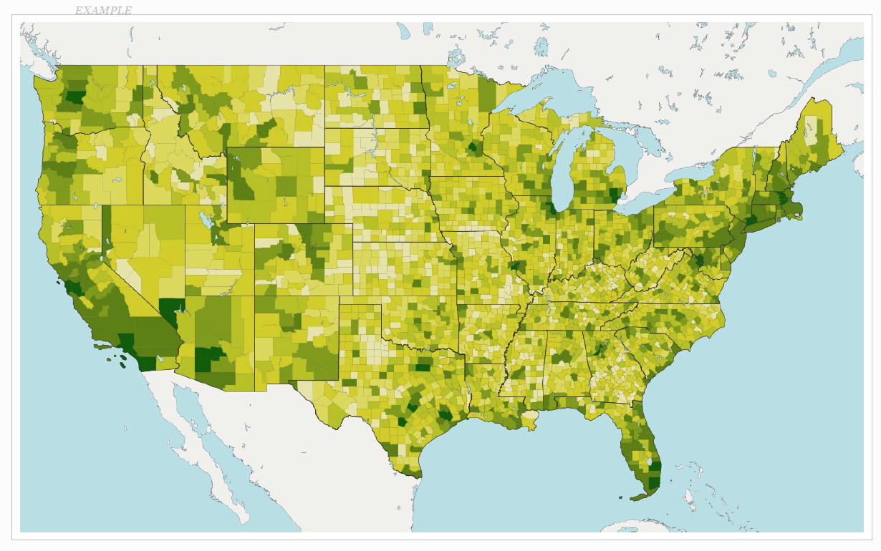
So far: Information Visualization

Slide 17
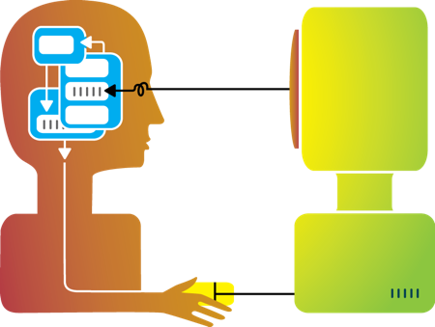
Flashback: about this workshop
Visualization
Interaction
Design
Interaction
Design

Slide 18
Interaction (def.)
Methods by which humans create knowledge through the manipulation of an interface
Low level: between human and interface
the set of operations available
the relationship between the human and the visualization
High level: between human and problem space
a cognitive act enabled by the tool
does not need to take place exclusively within them
might be distributed across multiple tools

Slide 19
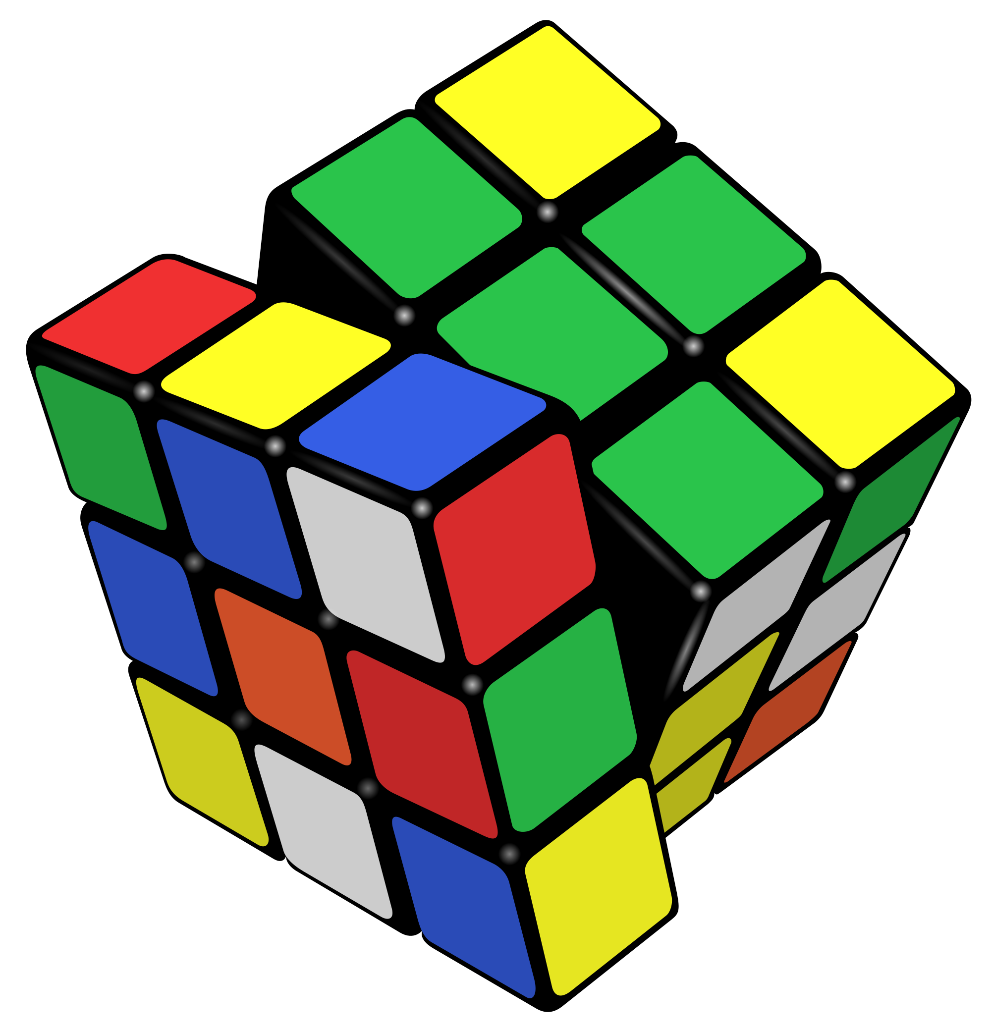
Example: Rubik’s Cube
What low-level interactions can you have?
What high-level interactions can you have?

Slide 20
Interaction and Analysis
Interaction is the observable result of a cognitive process: “an externalization of thought”
In visual analytics, there is a growing belief that interaction and analysis are one in the same
Analytic discourse: the idea that knowledge is constructed, tested, refined, and shared through the interactive manipulation of a visual interface¹
¹Pike, W. A., Stasko, J., Chang, R., & O'Connell, T. A. (2009).
The science of interaction. Information Visualization, 8(4), 263-274.

Slide 21
Part I: High Level
Interaction with
Data / Problem Space

Slide 22
Interaction as a Reasoning Aid
Interaction is situated in the context of a problem or goal-directed activity
This context helps the human identify relevant concepts and link them into appropriate structures
Interaction brings together background contexts and current observations
This is known as “situated cognition”

Slide 23
Reality Check
Hypothesis: the more ways a user can ‘touch’ their data (by changing their form or exploring them from different perspectives), the more insight will accumulate.

Slide 24

Interaction as Distributed Cognition
Visualization is often used as a tool to “offload” storage or computation from the human’s brain
In order for this to be useful, we have to be able to “reload” parts of the data and operate on it
Internal (in your head) vs. external (on the screen) representations
Consider the impact of the affordances of the interface

Slide 25
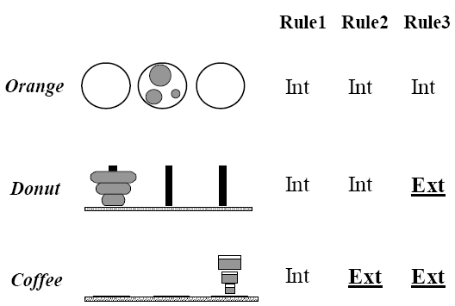
Example: Tower of Hanoi
Only one disk can be transferred at a time.
A disk can only be transferred to a pole on which it will be the largest.
Only the largest disk on a pole can be transferred to another pole.

Slide 26
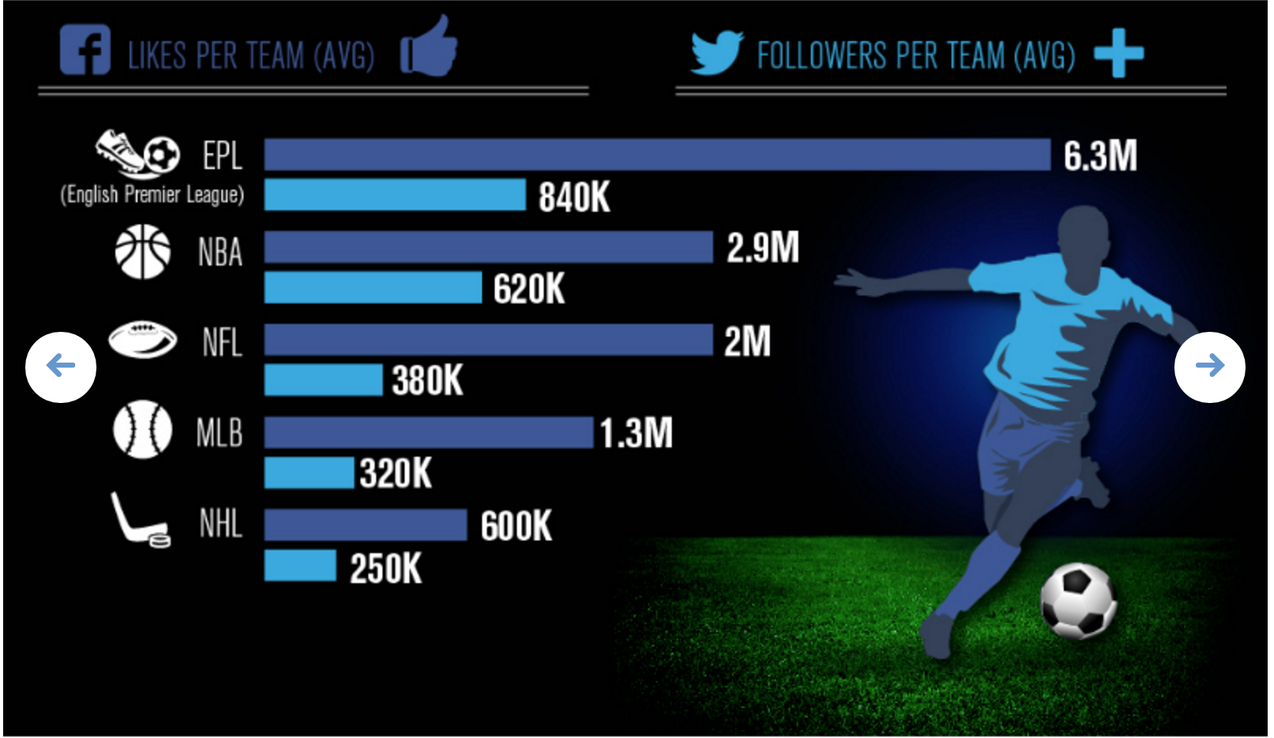
Flashback: #badvis
What representations are internal vs. external?

Slide 27
Pragmatic vs. Epistemic Action
Pragmatic actions move a person and their analysis closer to the desired destination.
Epistemic actions enable humans to leverage environmental structures to link internal structures.
The purpose of some actions is not for the effect they have on the environment but for the effect they have on the humans.

Slide 28
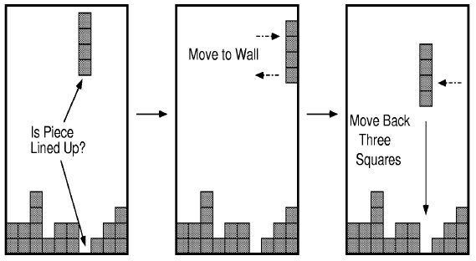
Example: Tetris

Slide 29
Part II
Interaction with
a Visual Interface

Slide 30
So far…
Visualization

Slide 31

Flashback: interaction as a reasoning aid
Interaction is situated in the context of a problem or goal-directed activity
Question: what kinds of things might someone want to do using a visualization?

Slide 32
Yi, Kang, Stasko and Jacko (2007)
Select: mark something as interesting
Explore: show me something else
Reconfigure: show me a different arrangement
Encode: show me a different representation
Abstract/Elaborate: show me more or less detail
Filter: show me something conditionally
Connect: show me related items
Select: mark something as interesting
Explore: show me something else
Reconfigure: show me a different arrangement
Encode: show me a different representation
Abstract/Elaborate: show me more or less detail
Filter: show me something conditionally
Connect: show me related items
Yi, J. S., ah Kang, Y., Stasko, J. T., & Jacko, J. A. (2007). Toward a deeper understanding of the role of interaction in information visualization. Visualization and Computer Graphics, IEEE Transactions on, 13(6), 1224-1231.

Slide 33
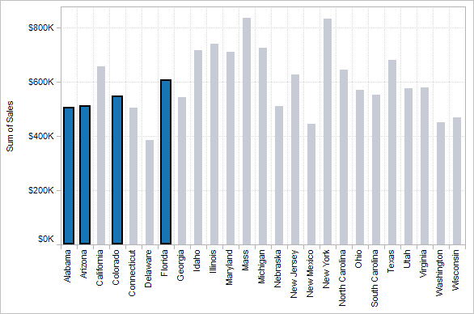
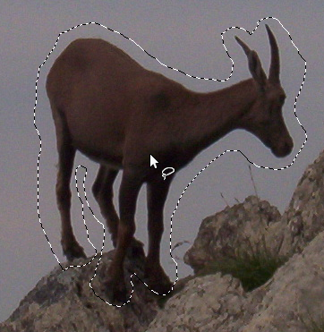

1. Select
Mark something as interesting: direct

Slide 34
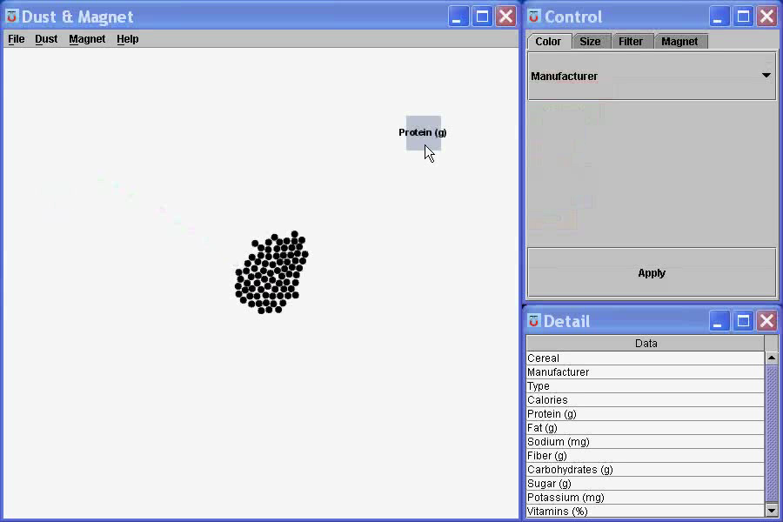
1. Select
Mark something as interesting: indirect
Notes:
What are you selecting? One item at a time?
Selecting of a value?
Selecting of a range?
Selecting of a position on the screen?

Slide 35
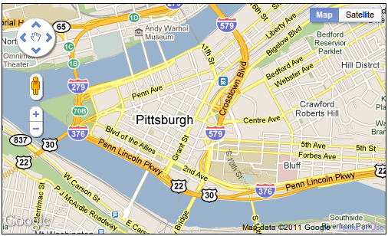
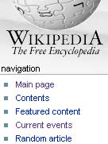
2. Explore
Show me something else
Scroll bars
Panning
Direct-Walk (e.g. hyperlink traversal)

Slide 36
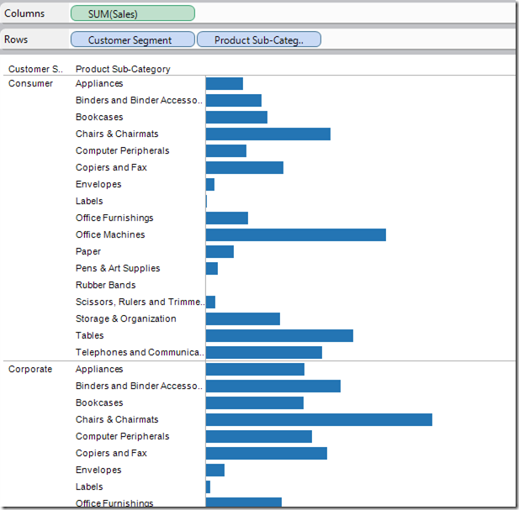
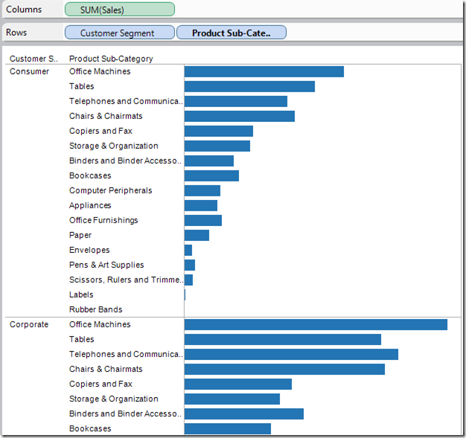
3. Reconfigure
Show me a different arrangement: sorting

Slide 37
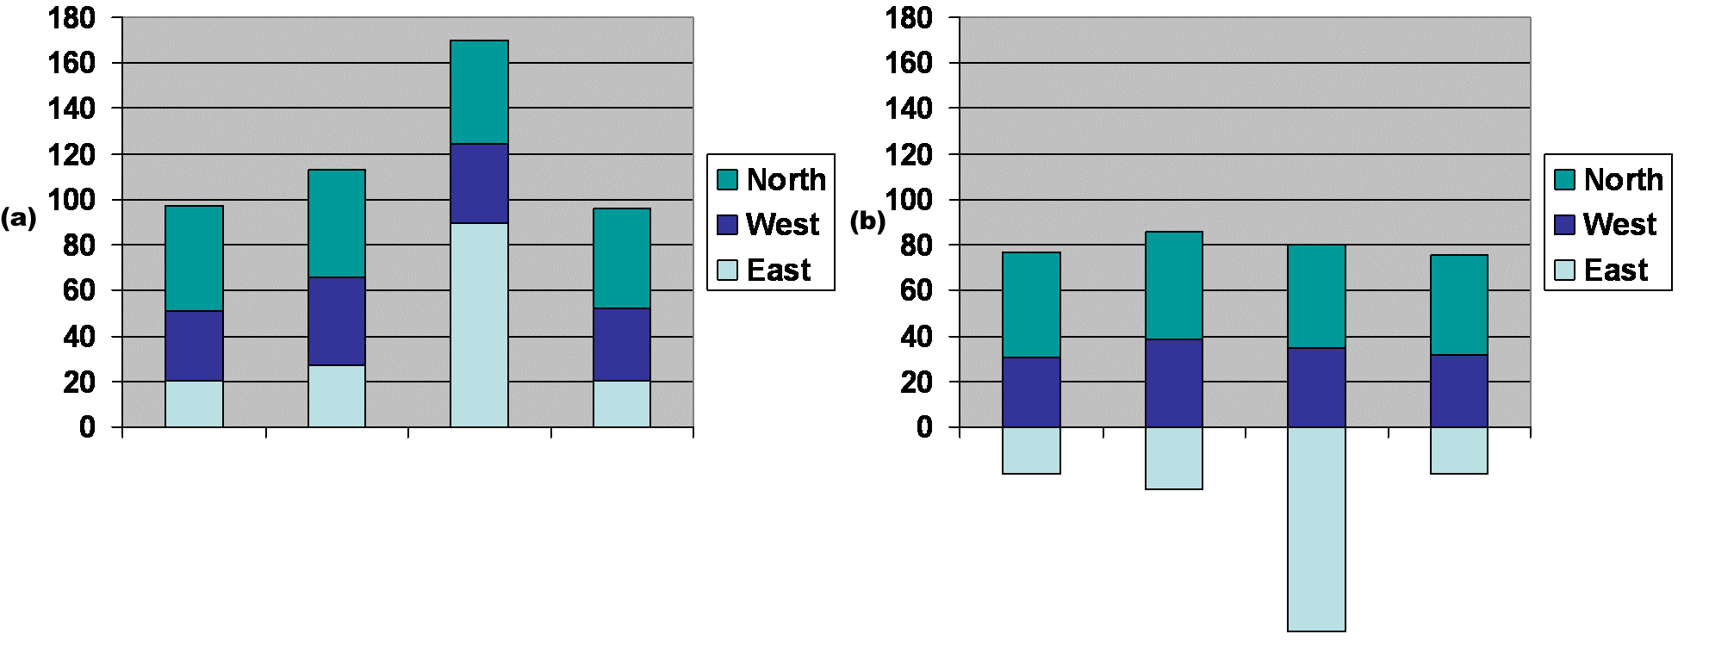
3. Reconfigure
Show me a different arrangement: baseline adjustment

Slide 38
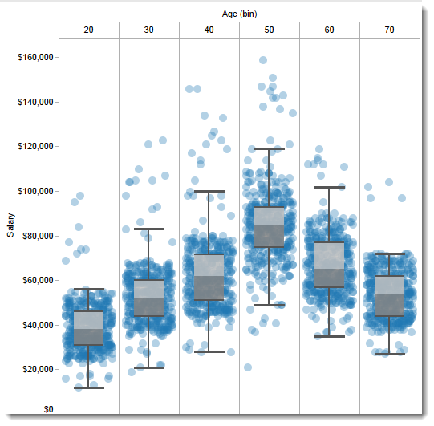
3. Reconfigure
Show me a different arrangement: reduce occlusion (jitter)

Slide 39
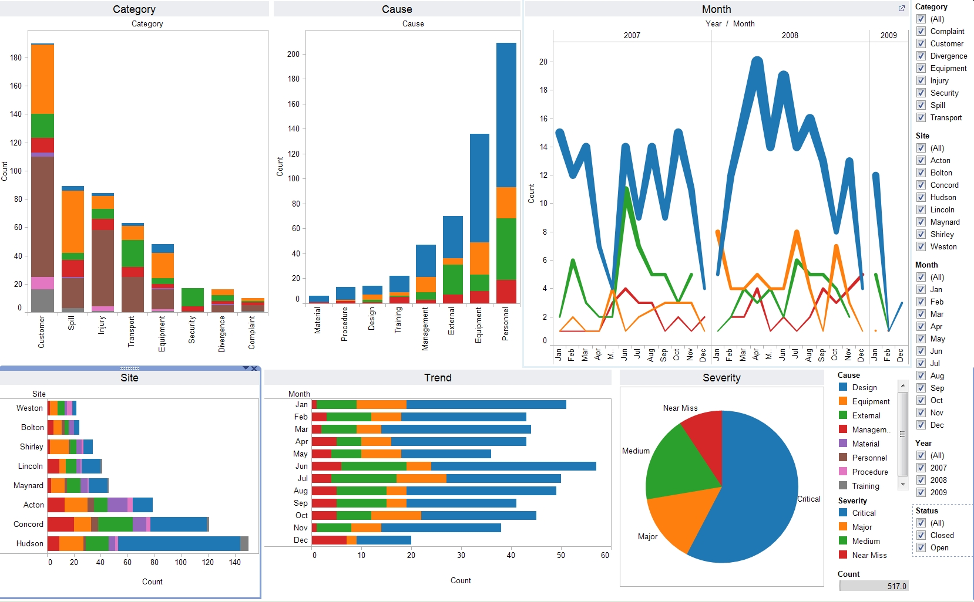
4. Encode
Show me a different representation: visualization type, color, size, orientation, etc.

Slide 40
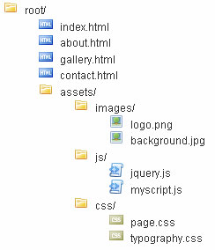
5. Abstract / Elaborate
Show me more or less detail: drill up/down

Slide 41
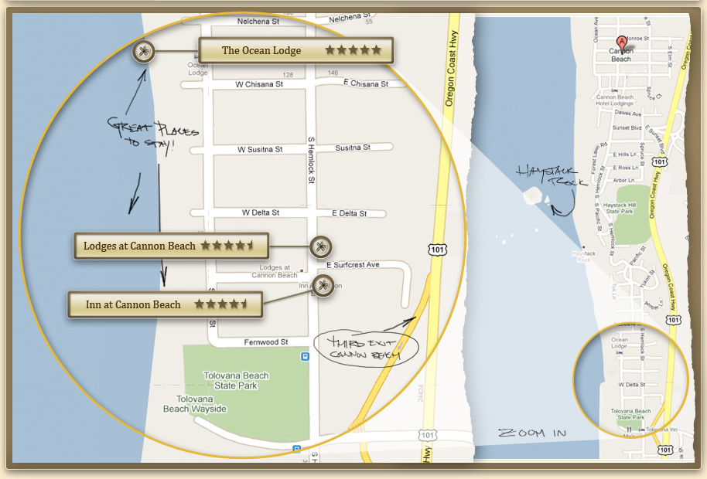
5. Abstract / Elaborate
Show me more or less detail: zooming

Slide 42
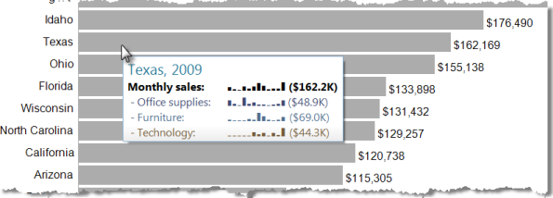
5. Abstract / Elaborate
Show me more or less detail: tooltips

Slide 43
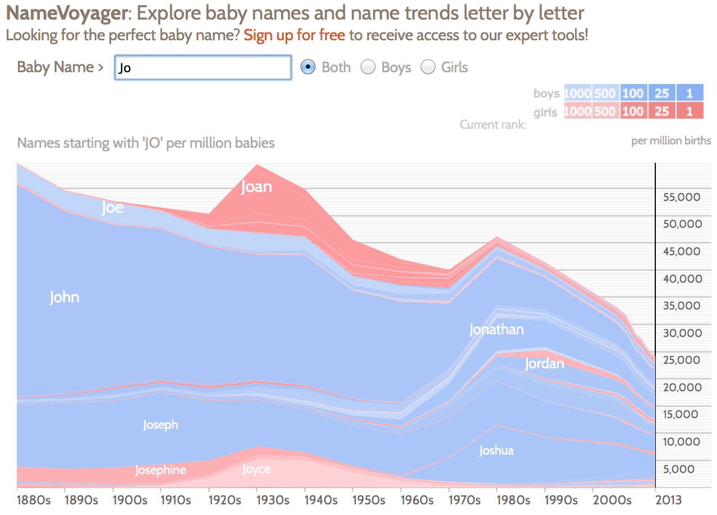
6. Filter
Show me something conditionally

Slide 44
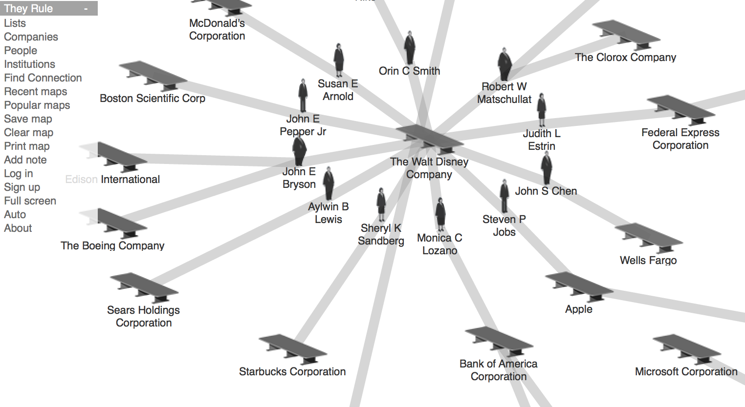
7. Connect
Show me related items: build-out

Slide 45
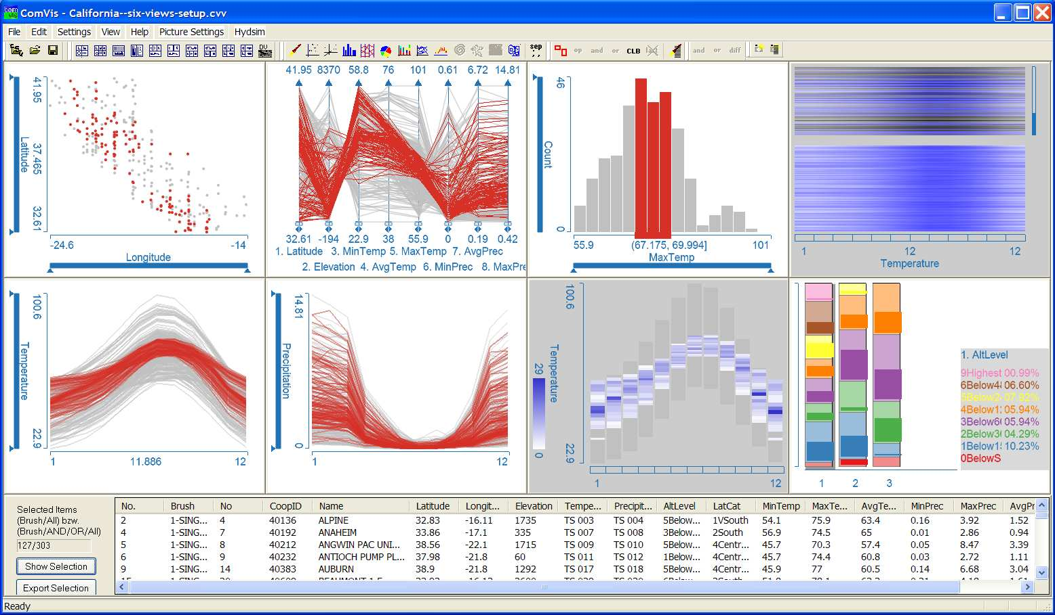
7. Connect
Show me related items: coordinated multiple views (CMV)

Slide 46
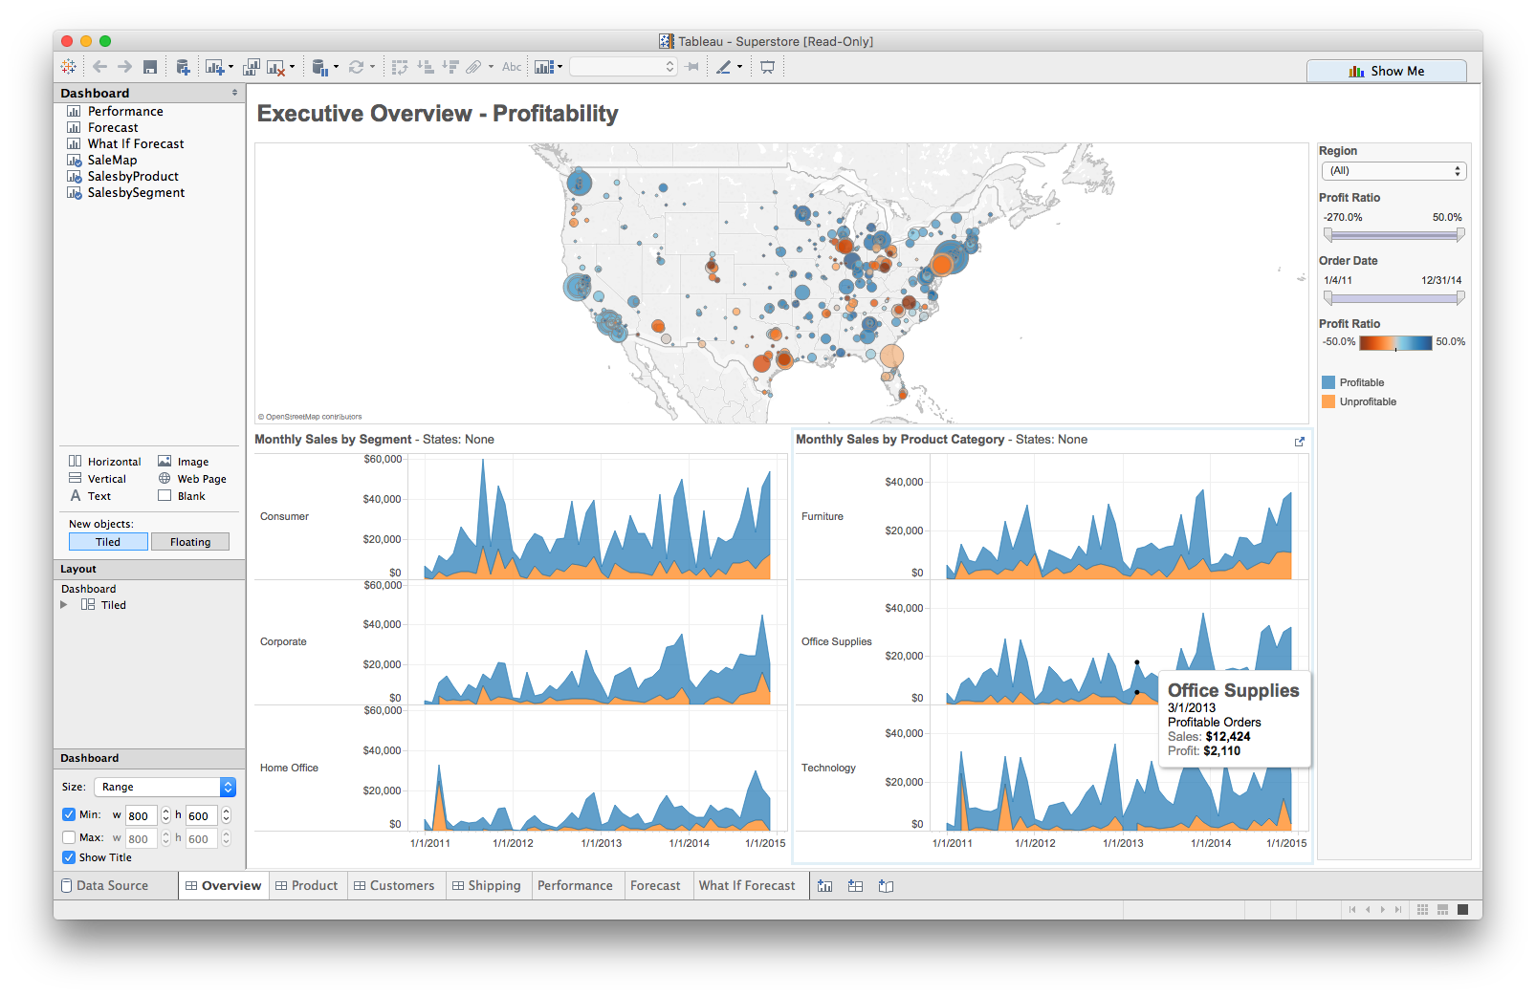
Multiple views
Different
representations
Different
data
Systems that use two or more distinct views
to support the exploration of a single concept or domain

Slide 47
When to use multiple views?
The data is too big
Lots of attributes
Lots of observations
The data is too complicated
Lots of data sources
Lots of data types
The data has several interesting parts, but no one visualization highlights them all

Slide 48
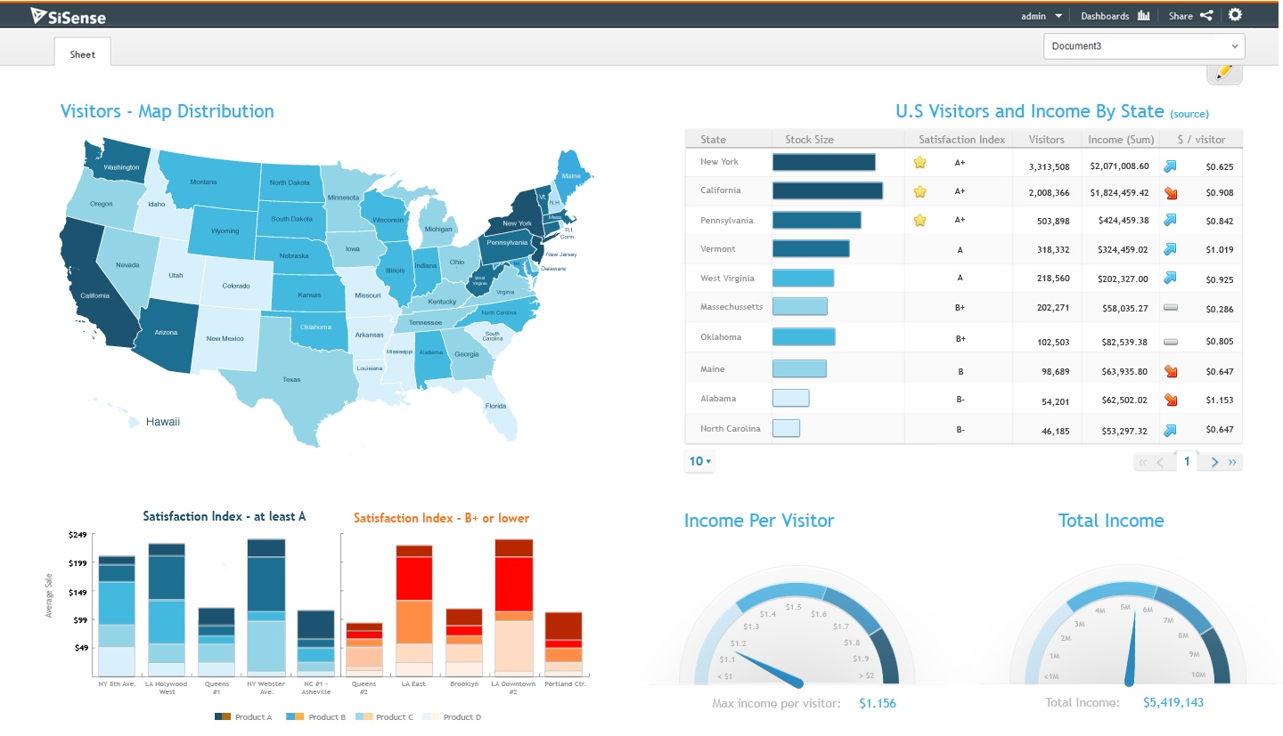
Need to think about: resource optimization

Slide 49
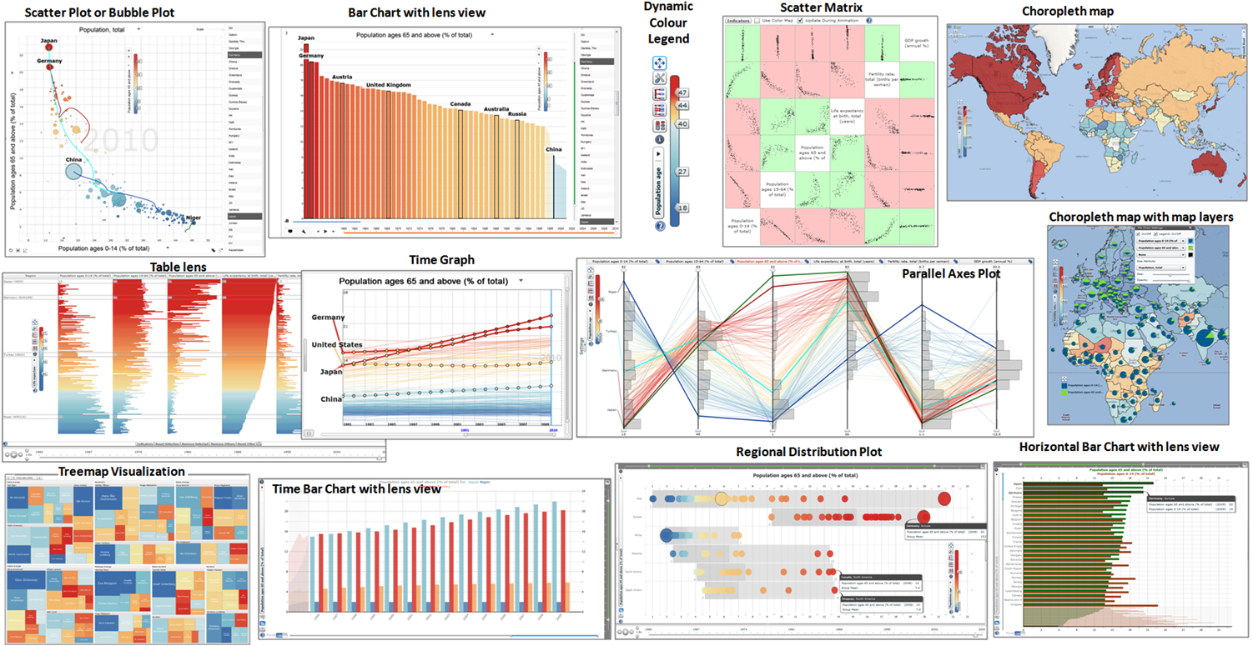
Need to think about: resource optimization

Slide 50
Guidelines for multiple views
Balance the costs of presenting multiple views with the benefits of using the views
Split complex data into multiple views to create manageable chunks
Use views that are complimentary, bringing out correlations and/or disparities
Use perceptual cues to:
make relationships more apparent to the reader
focus the reader’s attention on the right view at the right time

Slide 51
Coordination: brushing and linking
Big idea: actions in the real world have ripple effects; actions on a visualization should too
Brushing: the visualization responds (usually through highlighting) as a person “brushes past” data points
Linking: the visualization connects related data points across multiple views

Slide 52
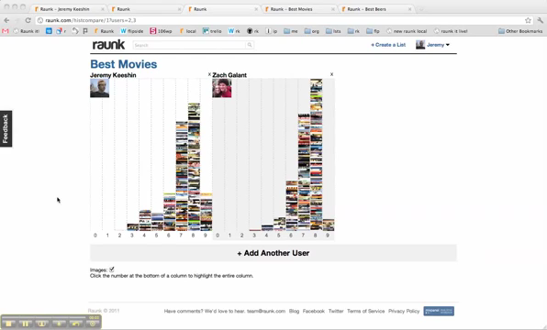
Coordination: brushing and linking

Slide 53
Coordinated multiple views
Multiple views + brushing and linking
Big idea: propagate interaction from one view to all others, respond as appropriate

Slide 54
Discussion
What would we need
to make this work?

Slide 55
Suggested questions to ask when designing
What is the goal of the analysis?
Decision-making
Better understand a domain or a problem
Identify the trends of a phenomenon
Forecast the future
…etc.
What kinds of operations do we need to enable?
How can the visualization support those operations?

Slide 57
Outline
Introduction to plot_ly() and ggplotly()
Case Study – Housing Sales in Texas
Using plot_ly()
Using ggplotly()
Combining views
with htmlwidgets
with shiny
with subplot(…)
Lab modeled on “The Plotly Cookbook” chapter
of the Plotly for R Masterclass by Carson Sievert,
plotly-book.cpsievert.me/the-plotly-cookbook.html

Slide 58
What you need to know
2 main ways to initiate a plotly object in R:
plot_ly() function transforms data into a plotly object
ggplotly() function transforms a ggplot object into a plotly object (Wickham 2009); (Sievert et al. 2016)
Both result in an interactive web-based visualization with tooltips, zooming, and panning enabled by default
Let’s play…

